Slide 1
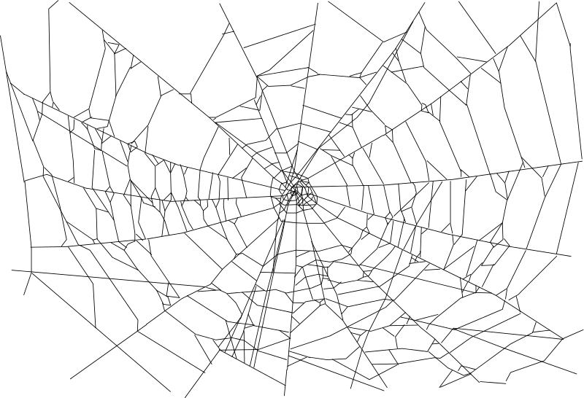
Coherence Theories
Kareem Khalifa
Philosophy Department
Middlebury College

Slide 2
Overview
Background
Positive Linear Coherentism
Positive Holistic Coherentism
Negative Coherentism
Isolation and the Doxastic Assumption

Slide 3
1. Background
“We are like sailors who on the open sea must reconstruct their ship but are never able to start afresh from the bottom. Where a beam is taken away a new one must at once be put there, and for this the rest of the ship is used as support. In this way, by using the old beams and driftwood the ship can be shaped entirely anew, but only by gradual reconstruction.”
Quine (paraphrasing Neurath), Word & Object, p.3
1.1. Why coherentism?

Slide 4
1. Background, Continued
1.2. Problems with Neurath
1.3. Positive & negative coherentism
1.4. Linear & holistic coherentism

Slide 5
2. Positive, Linear Coherentism
2.1. The Regress Argument
2.2. Creeping Foundationalism Objection

Slide 6
3. Positive, Holistic Coherentism
3.1. Lehrer’s View
3.2.Occurrent Belief Objection
3.3. Basing Objection

Slide 7
4. Negative Coherentism
4.1. Harman’s View
4.2. Negative Basing Objection
4.3. Automatic Defeater Objection

Slide 8
5. Isolation and the Doxastic Assumption
5.1. Isolation Objection
5.2. Nondoxastic theories of justification

